Slide 1
The role of national chemical industry associations and the National Authorities in continually improving the efficiency and effectiveness of Article VI verification FIFTH ANNUAL MEETING OF CHEMICAL INDUSTRY REPRESENTATIVES AND NATIONAL AUTHORITIES OF STATES PARTIES TO THE CHEMICAL WEAPONS CONVENTION (CWC)
Dr. Detlef Maennig, ICCA
Doha, Qatar, 2-4 October 2018

Slide 2
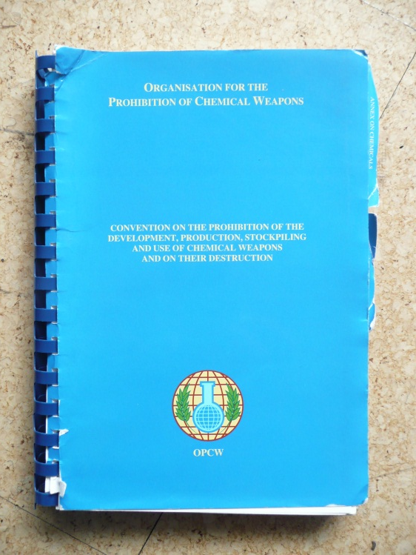
„…Achievements in the field of chemistry should be exclusively for the benefit of mankind…“
(Preamble of CWC)

Slide 3
ICCA welcomes the opportunity to provide input to the annual meeting of chemical industry representatives and National Authorities. This presentation comprises the following: 1. Introduction to ICCA 2. Trends in global chemical industry growth 3. Future priorities of the OPCW from ICCA point of view 4. Verification in chemical industry 5. Cooperation between ICCA, OPCW and National Authorities

Slide 4
What is the International Council of Chemical Associations (ICCA)?
Worldwide voice of the chemical industry
Turnover of more than €3,600 billion
Accounts for more than 90 % of global chemical sales
More than 16.5 million employed directly or indirectly
Global, virtual organization
Coordinating associations and their members
Strengthen existing cooperation with international organizations, governments and NGOs
www.icca-chem.org

Slide 5
Partnerships and Alliances with relevance to CWC (examples)
Organisation for the Prohibition of Chemical Weapons (OPCW): Joint Steering Committee and Chemical Industry Coordination Group
United Nations Environment Programme (UNEP): - APELL (Awareness and Preparedness for Emergencies at Local Level) - Safer Production and Corporate Social Responsibility
United Nations Institute for Training and Research (UNITAR): - Implementation of the Globally Harmonized System of Classification and Labeling of Chemicals
Organisation for Economic Co-operation & Development (OECD): Nanomaterials, Biotechnology
United Nations’ Strategic Approach to International Chemicals Management (SAICM)

Slide 6
Membership criteria
The leading association/federation in the country or region
Committed to ICCA-approved principles and features
In the process of adopting and/or implementing Responsible Care®
Working with member companies to improve health, safety and environmental performance
In line with ICCA vision, mission, and strategic goals
Supportive of ICCA work and its voluntary initiatives
Committed to meet the criteria for full membership within a five-year timeframe
Support the Chemical Weapons Convention
!

Slide 7
ICCA Membership
European Chemical Industry Council (Cefic)
North American Council of Chemical Associations (the associations of Canada, Mexico, and the United States)
Conselho da Industria Quimica do Mercosul (CIQUIM, chemical associations of South America – Brazil, Uruguay, Chile, Peru and Paraguay)
The Japan Chemical Industry Association (JCIA)
The Korea Chemical Industry Council (KOCIC)
The Plastics and Chemicals Industries Association (PACIA, Australia), and Responsible Care New Zealand (RCNZ)
The Chemical and Allied Industries’ Association (CAIA, South Africa)
The Singapore Chemical Industry Council (SCIC)
Gulf Petrochemical and Chemical Associations (GPCA)
FULL MEMBERS

Slide 8
ICCA Membership
China associations
(CPCIF, AICM, and TRCA, PIAT, and TCIA)
Russian Chemist Union (RCU)
Indian Chemical Council (ICC)
OBSERVER MEMBERS

Slide 9
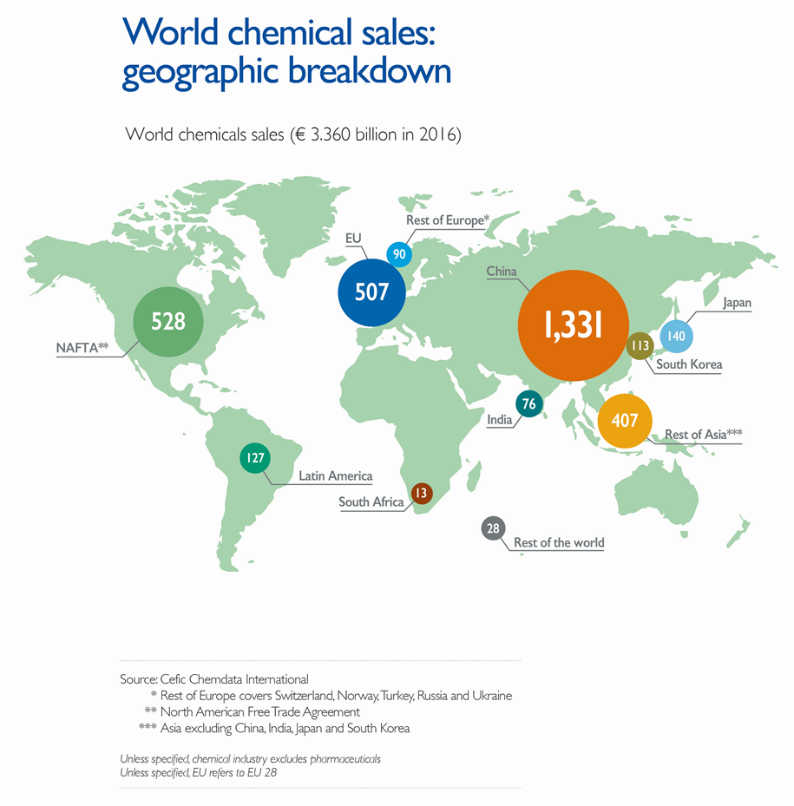
Asia chemicals production outpaces other regions (World chemicals sales € 3,360 in 2016 : geographic breakdown)

Slide 10
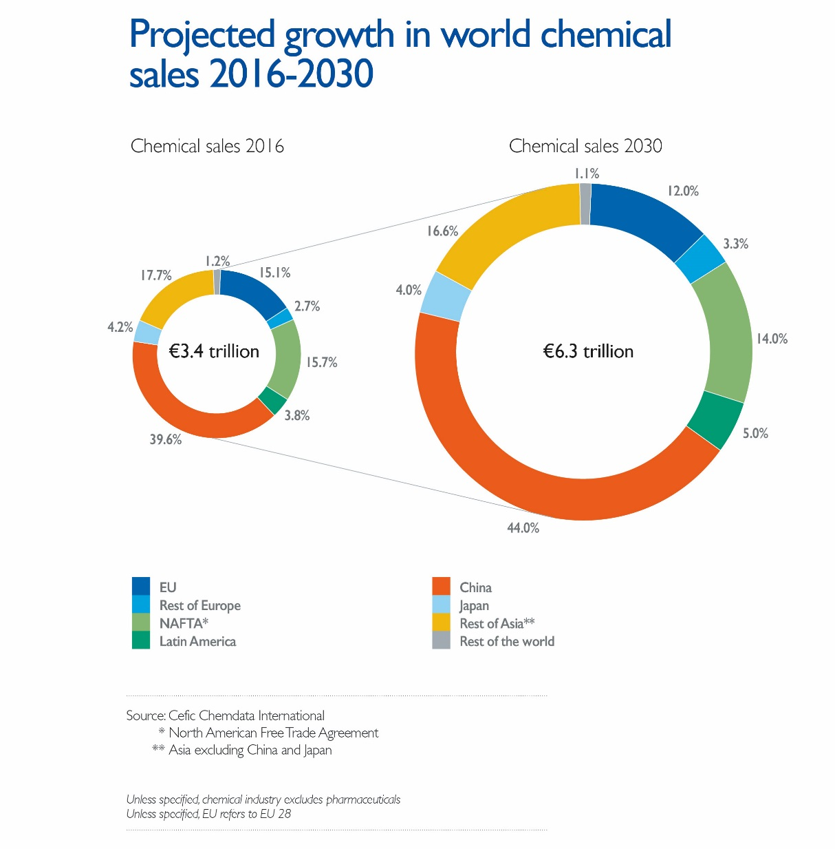
Trends in overall growth expected to continue (Projected growth in world chemical sales 2016-2030)

Slide 11
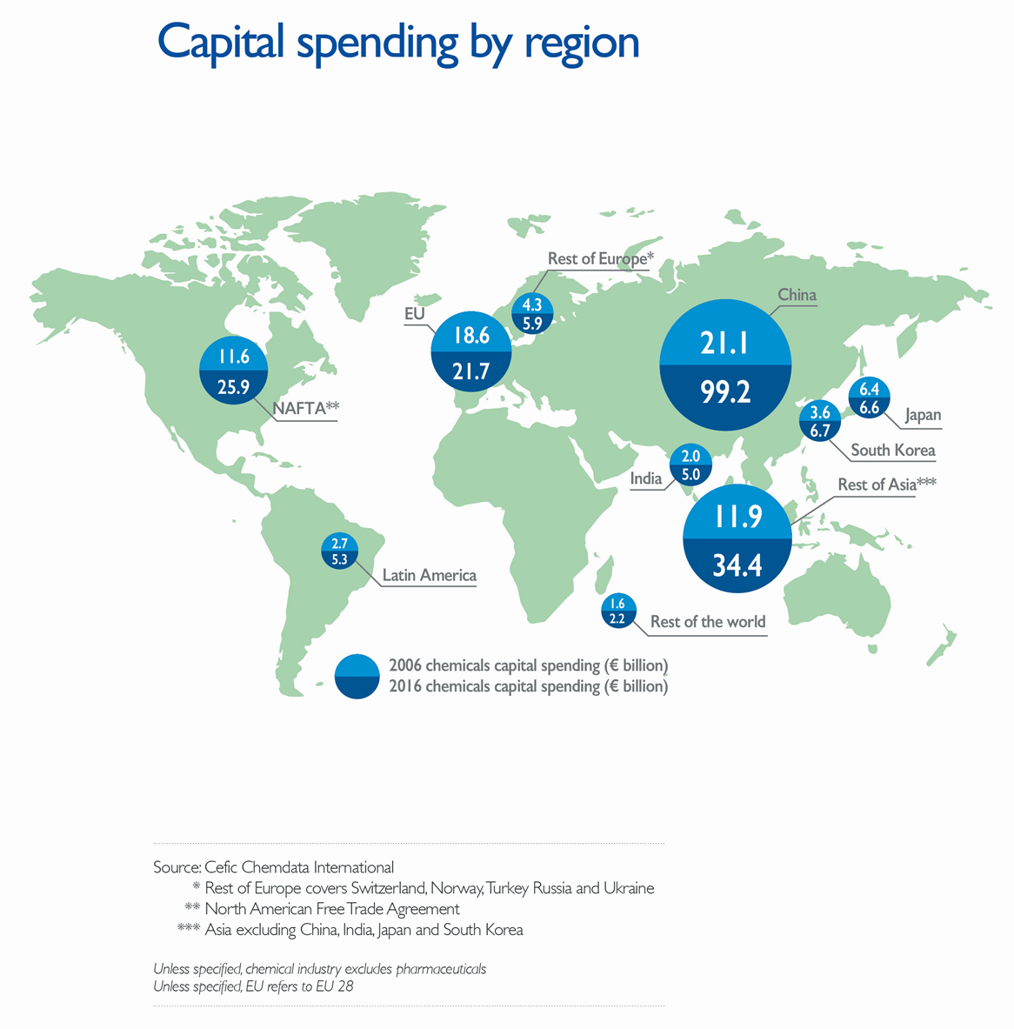
China dominates world chemical investments (Capital spending by region)

Slide 12
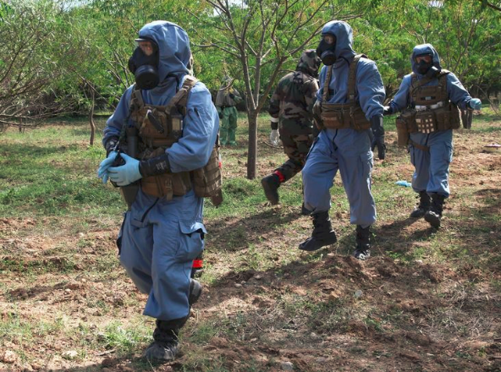
Comments on Future Priorities I
The main focus of the OPCW should remain on the eliminating and preventing the use of chemistry for weapons purposes. Article XI activities should build on existing programs in order to avoid duplication.
Chemical industry has given full support to the goals and objectives of the CWC including its verification regime.
However, there are still substantial differences in the degree of implementation at the national level. This needs to remain a priority with States Parties and all bodies of the OPCW.
As the cases of Syria, UK (Skripals and others) and Malaysia (Kim Jong-nam) show, OPCW needs to maintain capacities to address Alleged Use and Challenge Inspections.
Photo: courtesy OPCW

Slide 13
Comments on Future Priorities II
We agree that the focus should be on implementing the provisions of the CWC, rather than attempting to revise the treaty.
The continuing avoidance of challenge inspections, which are a true deterrence to violations of the CWC, undermines confidence. There are numerous recent events, where it should have been applied.
The recent discussions centering on expanding verification activities at OCPFs (mixtures and biobased processes) are troubling. The Organization and States Parties should consider measures that effectively ease the compliance burden for both industry and States Parties.
Confidentiality to be maintained as priority issue
Some companies report that S&A and more detailed documentation review put a strain on inspected companies and lead to potential conflicts with labor laws.

Slide 14
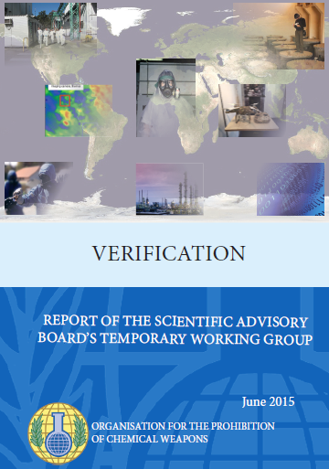
Verification in the chemical industry
ICCA welcomes any initiatives to increase the overall effectiveness and efficiency of verification activities (SAB report on verification). Taking a holistic approach, i.e.: - using synergies between Divisions - applying good Management Practices and Quality Assurance methods - using state-of-the-art equipment and technologies - making inspection frequencies dependent on past performance - learning lessons from past activities (such as Syria) - monitoring developments in Science & Technology will further help make best use of available resources.

Slide 15
Verification in the chemical industry
To increase the transparency, efficiency and effectiveness of the verification regime ICCA requests as regards the distribution of Art VI inspection resources:
To review the appropriateness of periodic re-inspection of Schedule 2 and Schedule 3 plant sites every 2-3 years, i.e. to review the existing distribution of Art VI inspection resources based on the current selection rules.
As a consequence, the total number of inspections has to be reviewed as well.

Slide 16
Cooperation between ICCA, OPCW and NAs

Slide 17
ICCA and the CWC
ICCA-OPCW enhanced cooperation agreement approved by ICCA Board and Conference of States Parties to the CWC.
Leverage Responsible Care in other regions.
Engage industry support for CWC implementation.
Established two new bodies: - Chemical Industry Coordinating Group (CICG) - Joint Steering Committee (JSC)
Notes:
At its meeting in Dubai last year, the Steering Committee recommended that the Board of Directors approve the OPCW proposal to enhance the cooperative relationship between the industry and the organization. The ICCA Board agreed with the recommendation and approved the proposal in June, 2015.
Since then, we have taken a number of steps to implement the agreement. Progress has been slow but steady, but we are expecting more activity as 2016 continues. I will outline some of those activities for you today.
There is a compelling logic to the industry’s enhanced cooperation with the OPCW:
Support for the CWC is a condition of membership in the ICCA
Since the CWC entered into force, nearly 2600 inspections have taken place at over 1100 industry facilities in 81 nations worldwide.
CWC compliance issues remain for industry, including the methodology by which industry facilities are selected for inspection, and the geographical distribution of inspections.
The Responsible Care program provides a basis for industry best practices to address process safety, product stewardship and security – and the chemical industry should be able to get credit for its Responsible Care activities.

Slide 18
Organizing the Dialogue
Joint Steering Committee
Manage industry-OPCW relationship
Industry Members:
ICCA Council Secretary (M. Mensink)
CICG Chair (D. Maennig, Evonik)
Senior Representatives of other regions (tbd)
TS members:
Director General
Directors VER, OSP, ICA
Notes:
The primary objective of our relationship with OPCW is to create a sustainable dialogue between industry and the organization, including the member governments.
A Joint Steering Committee has been formed. Its mission is to manage the overall relationship, and provide oversight and direction to the work of the Chemical Industry Coordination Group. The ICCA Council Secretary (currently Cal Dooley) is a member of the Joint Steering Committee, and I am a member in my role as co-chair of the Chemical Industry Coordinating Group.
We are actively engaged in seeking another industry representative from another region. We have made inquiries of several representatives and hope to name a representative very soon.

Slide 19
Chemical industry and National Authorities
The private sector is not only an important stakeholder and partner in implementation, but can be a resource, i.a. to:
Share best practices
Provide expertise about products, services, know-how and complex supply chains to regulators
Use associations and networks to disseminate relevant information
Give feedback about effectiveness of proposed and existing legislation
Share experiences from other control regimes →

Slide 20
Dialogue is key to success
Strengthen consultation mechanisms between governments and industry
Allow industry to comment on new concepts, and subject new concepts to test runs together with industry before implementation
Participation in expert hearings
Ability to provide written submissions, position papers
Participate in conferences, seminars etc.
Keep industry informed about upcoming changes
Work with industry regarding issues for industry
“Sharing is Caring” – governmental authorities and industrial players can form a trustful partnership

Slide 21
Summary regarding ICCA views
The verification regime under VA, Part VI to IX has by and large proven successful.
Thousands of inspections have been conducted in a professional manner, increasing confidence among States Parties.
Industry is concerned about potential changes being considered for the verification regime and the impacts on inspectable sites (mixtures and biobased processes).
Such fundamental changes need to be carefully addressed and without hurry.
Chemical Industry is ready to contribute to the further discussions.
Continued representation of industry in the SAB and ABEO should be priority.

Slide 22
Thank you for your interest! Any questions?

Slide 23
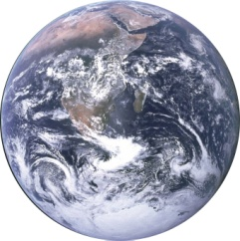
CWC & other regimes
REACH
Montreal Protocol
www.unep.ch/ozone/Publications/MP_Handbook/index.shtml
chm.pops.int
www.pic.int
www.basel.int
www.incb.org
3 Conventions on drugs, psychotropic substances, precursors, other chemicals
www.fatf-gafi.org
money laundry – terror
financing
www.opcw.org
Voluntary warning lists
Importer/Exporter
Sanctions, embargos
www.wassenaar.org
www.australiagroup.net
US Re–Export Regulation
International Security Initiatives
AEO, C-TPAT, CSI
National regulations
www.mtcr.info
→
www.nuclearsuppliersgroup.org

